Slide 1
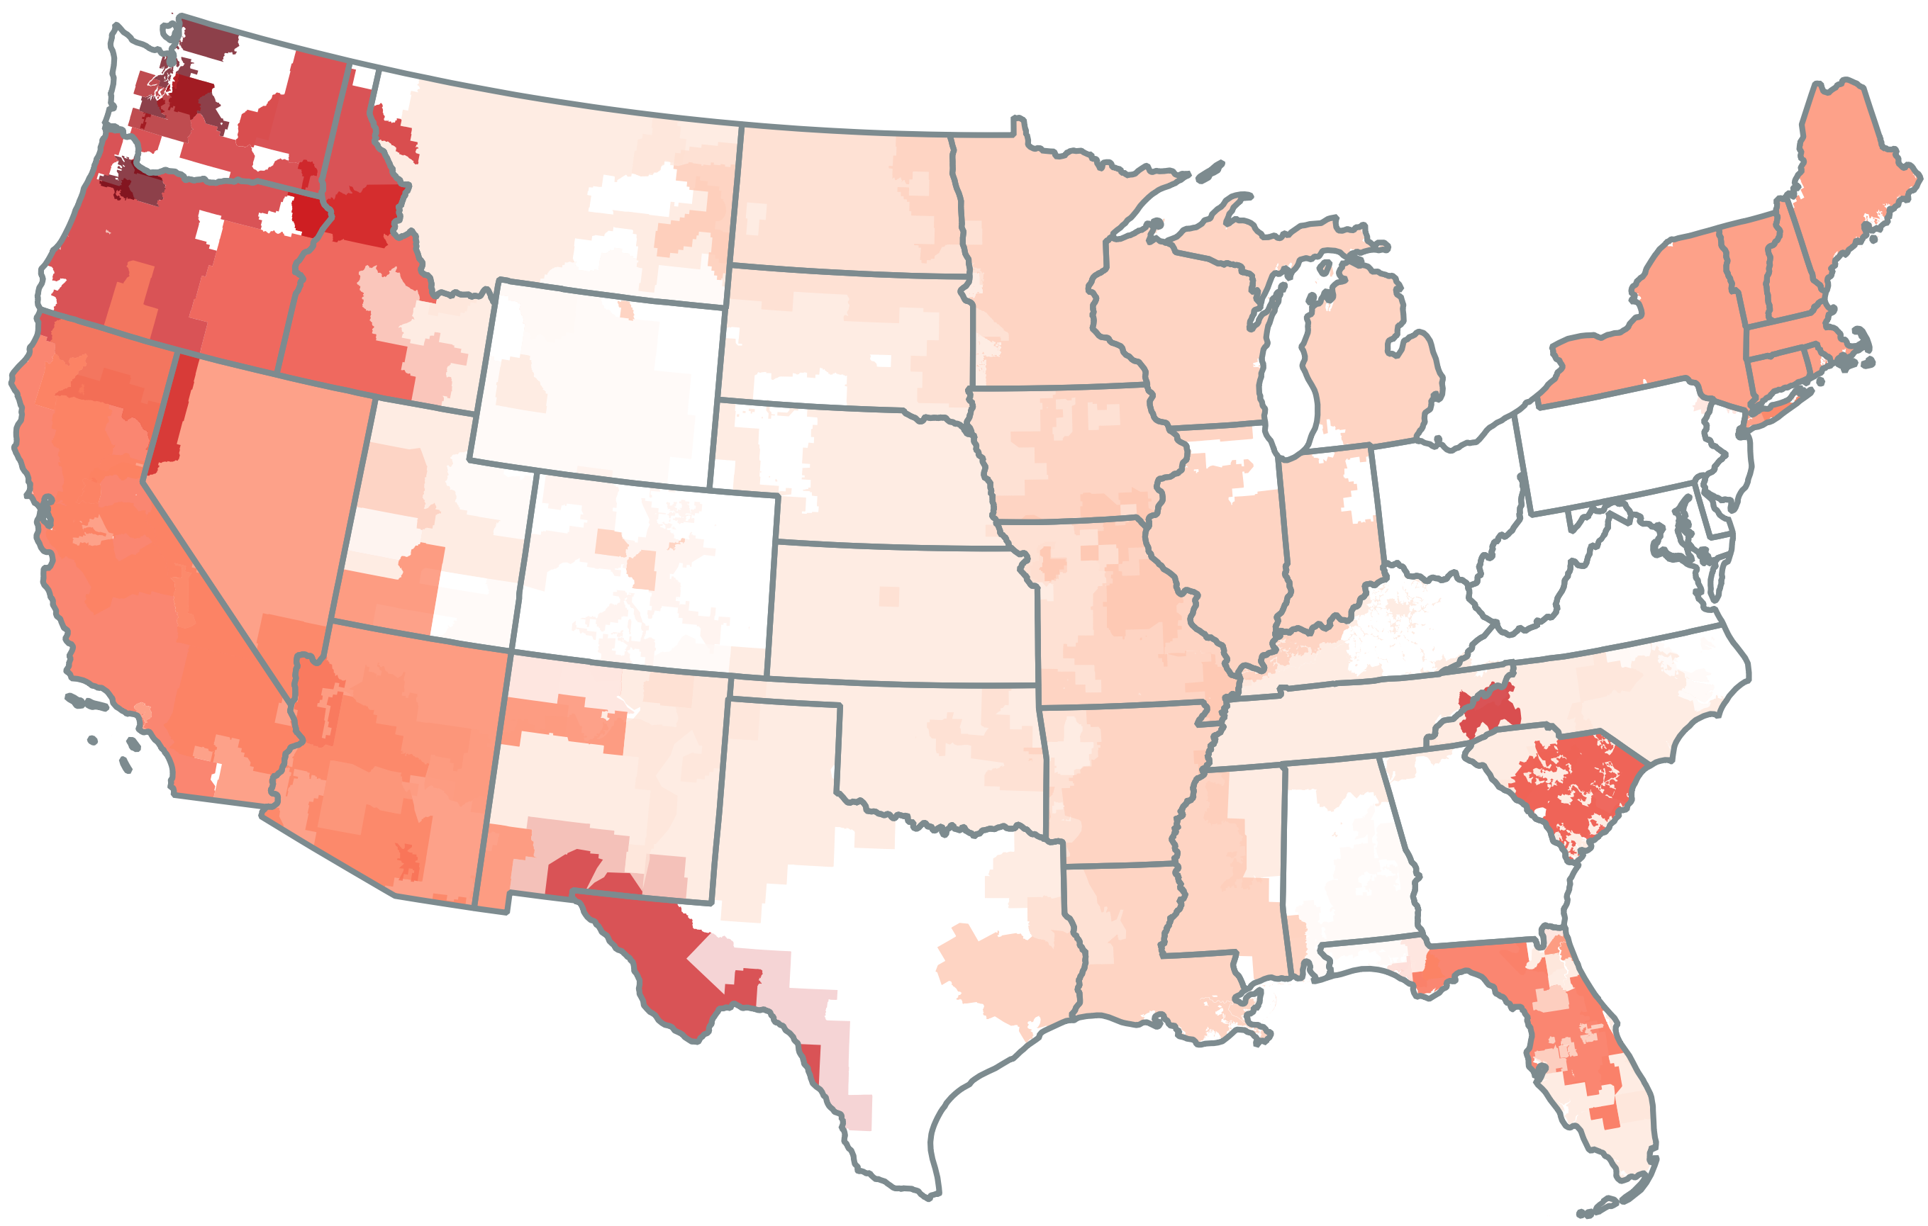
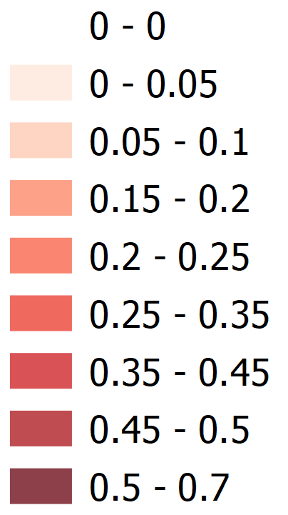
FIGURE: Import reliance as a share of total energy by U.S. Balancing Authority, 2016-2023

Slide 2
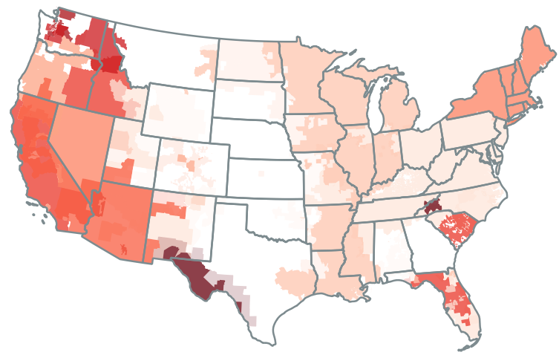
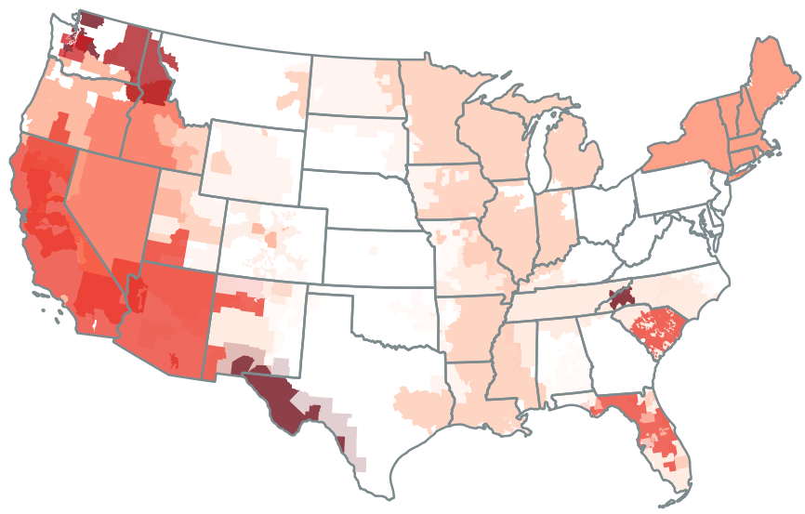
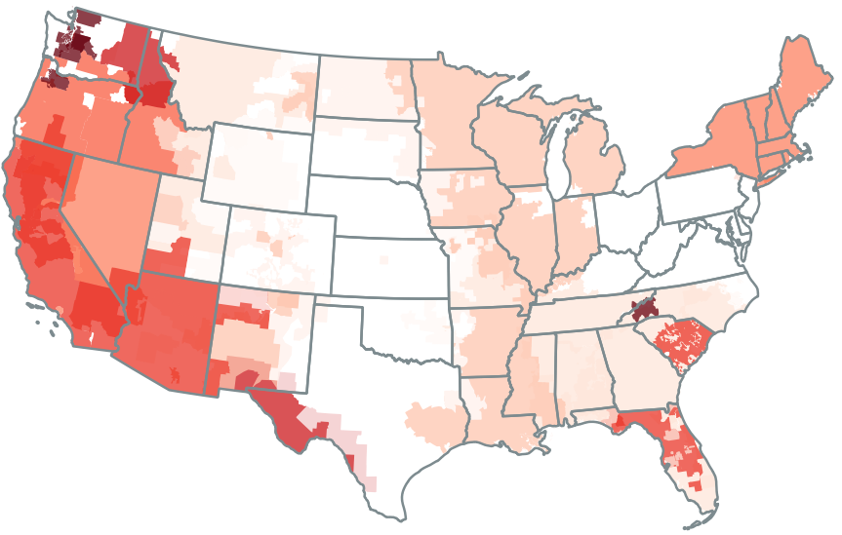
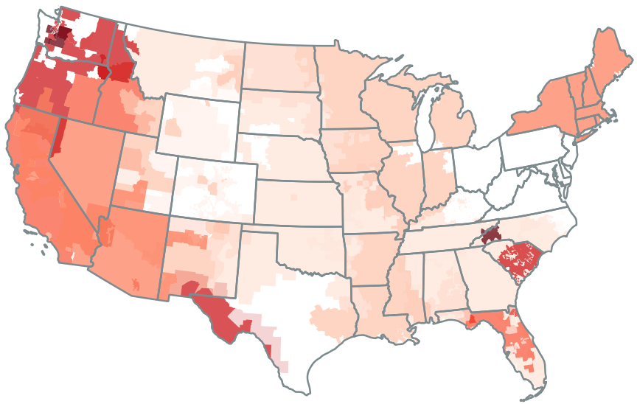
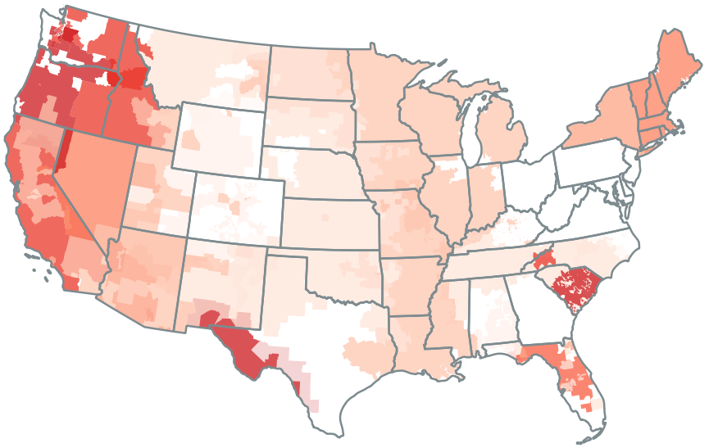

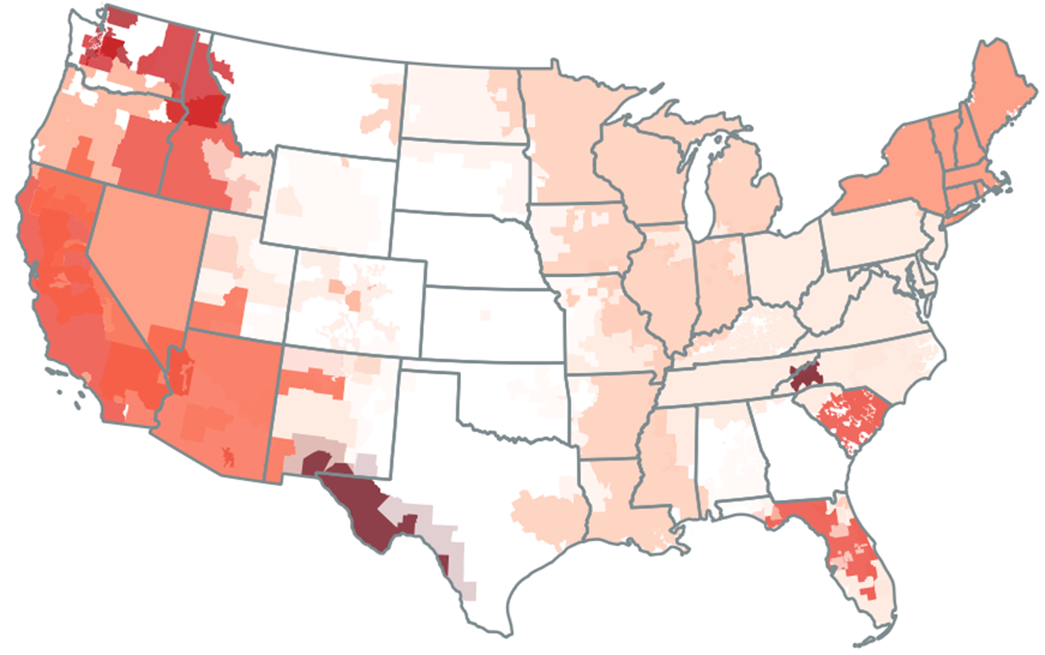

2016
2017
2018
2019
2020
2021
2022
2023

Slide 3
2016

Slide 4
2017

Slide 5
2018

Slide 6
2019

Slide 7
2020

Slide 8

2021

Slide 9

2022

Slide 10

2023

